Slide 1
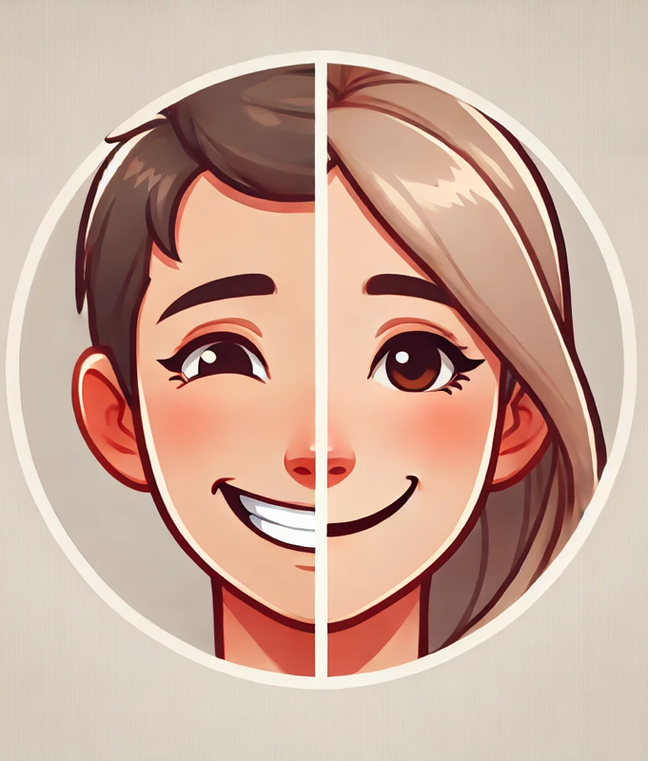
D-FuseSmileNet: Enhancing spontaneous smile recognition via
Hadamard fusion of handcrafted and deep-learning based features
Mohammad Junayed Hasan
Swarali Mahimkar
Prajakta Shevakari

Slide 2
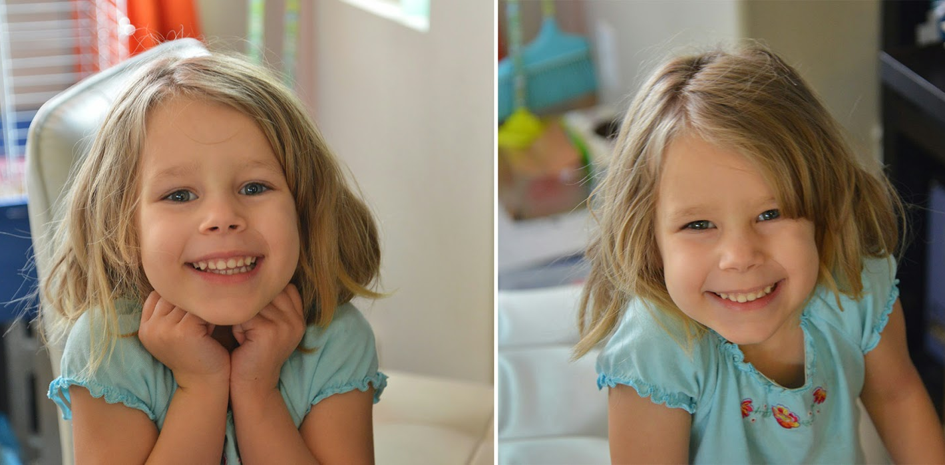

Slide 3
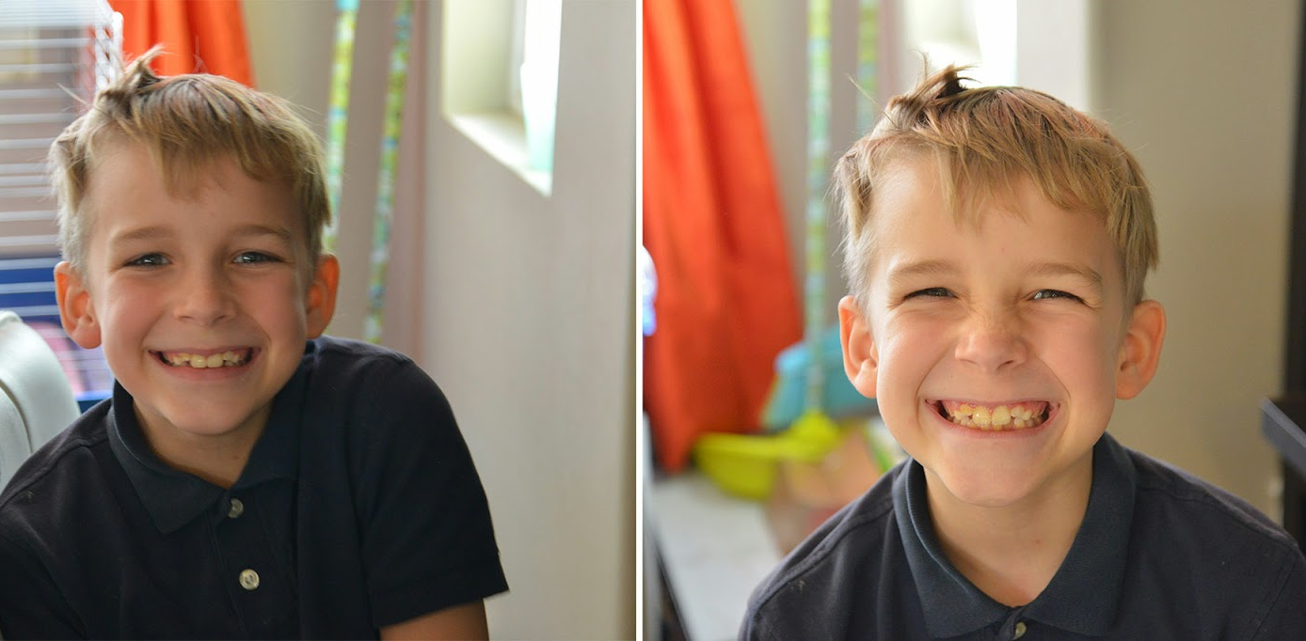

Slide 4
Contents
Background
Motivation
Materials Used
Our Method
Results
Comparison with SOTA
Conclusion and Future Work

Slide 5
Background
Facial Expressions and Smiles
Facial expressions are a universal form of non-verbal communication, essential for social interactions and human-computer interfaces.
Smiles, especially, play a key role in emotional expression and interaction.
Spontaneous vs. Posed Smiles
Spontaneous (Duchenne) smiles involve authentic emotions, with distinct muscle activations like eye crinkling.
Posed (non-Duchenne) smiles are deliberate and lack certain natural muscle movements.
Differentiating between the two is challenging due to subtle differences in facial dynamics.
Applications
Healthcare diagnostics: Assists in understanding emotional well-being.
Psychological research, criminology, and marketing: Supports studies on behavior and consumer responses.
Social robotics: Enhances robots' ability to gauge emotions and improve social acceptance.
Human-computer interaction: Enables emotionally intelligent systems.

Slide 6
Limitation of Existing methods
Feature-Based Methods:
Require manual annotation, which is labor-intensive and demands domain expertise.
Sensitive to variations (e.g., lighting, pose, occlusions), limiting robustness.
Struggle with generalization and fail to capture complex, non-linear relationships.
2. Deep Learning Methods:
Require large datasets and high computational resources.
Prone to overfitting and may learn irrelevant patterns.
Often ignore domain-specific cues like Duchenne Markers (D-Markers), reducing interpretability and missing critical discriminative information.

Slide 7
Motivation
Multi-task learning frameworks like DeepMarkerNet which is a recently proposed framework improve performance but face challenges:
Complex training procedures due to intricate loss-weighting schemes.
Inefficient integration of handcrafted and learned features, treating D-Markers as secondary rather than core features.
Limited interpretability despite added complexity, with suboptimal feature utilization.

Slide 8
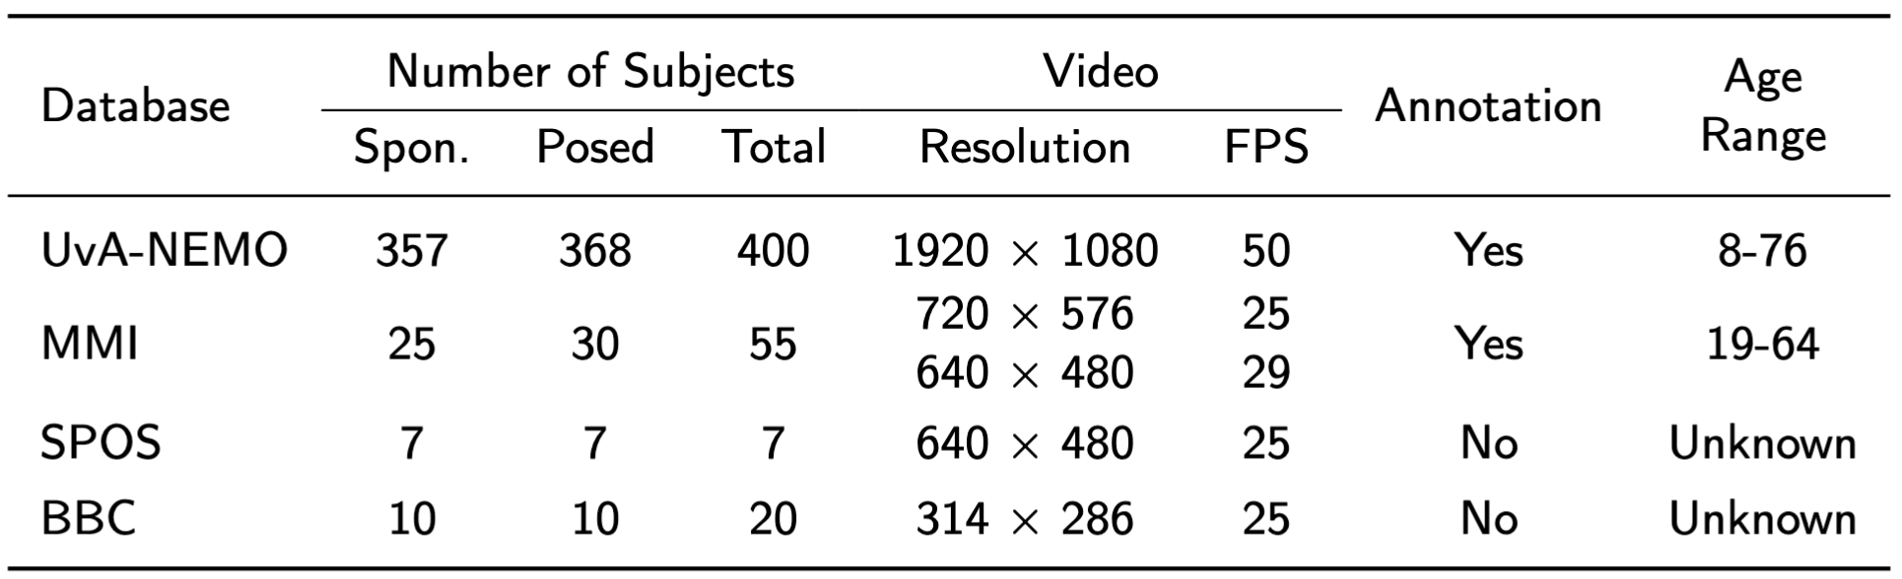
Materials Used
Datasets
Experimentation
Framework used: PyTorch
Compute: NVIDIA Tesla T4 GPU on the AWS EC2 server
14GB Tensor Core GPU
32GB RAM
# of video frames chosen: 16
Epochs: 300
Evaluation Protocol
UvA-NEMO and BBC – 10-fold CV
MMI – 9-fold CV
SPOS – 7-fold CV
Main metric: Classification accuracy (%)

Slide 9
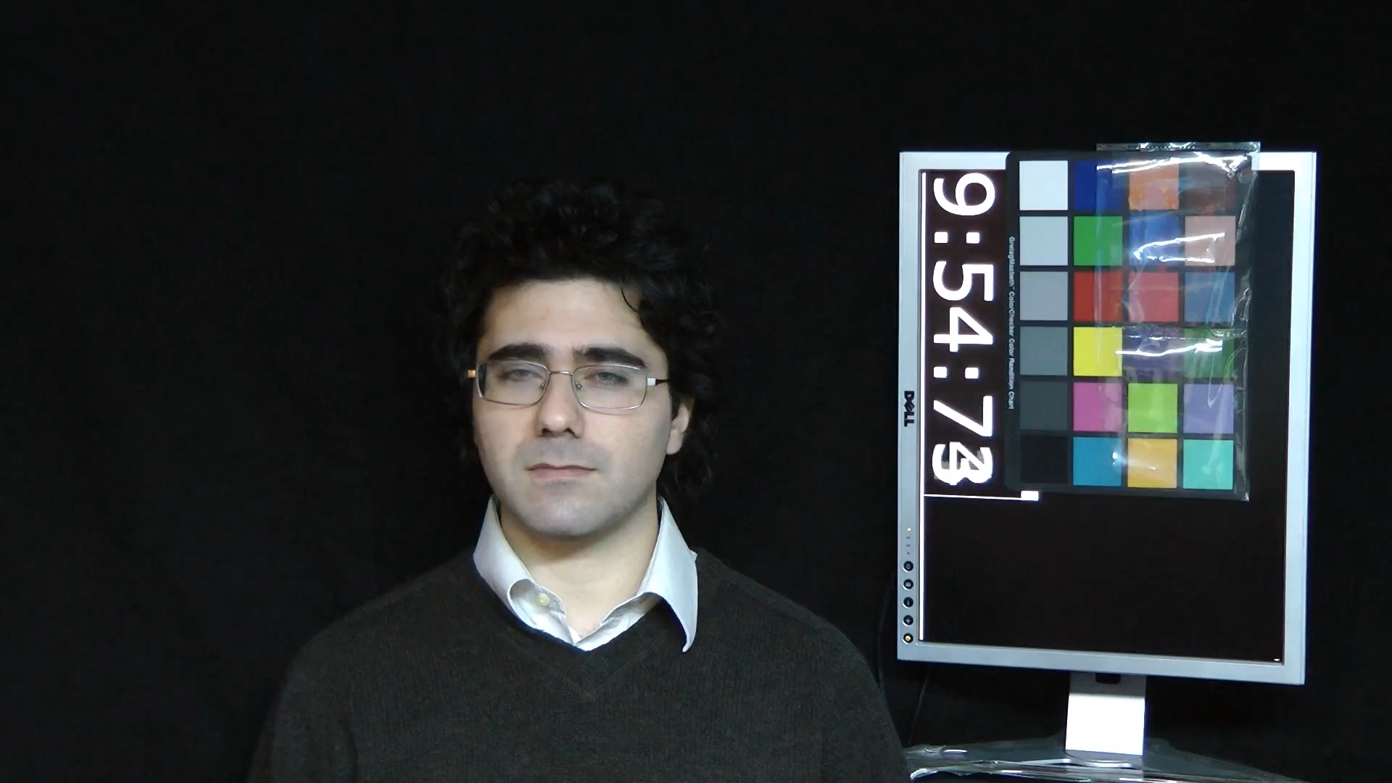
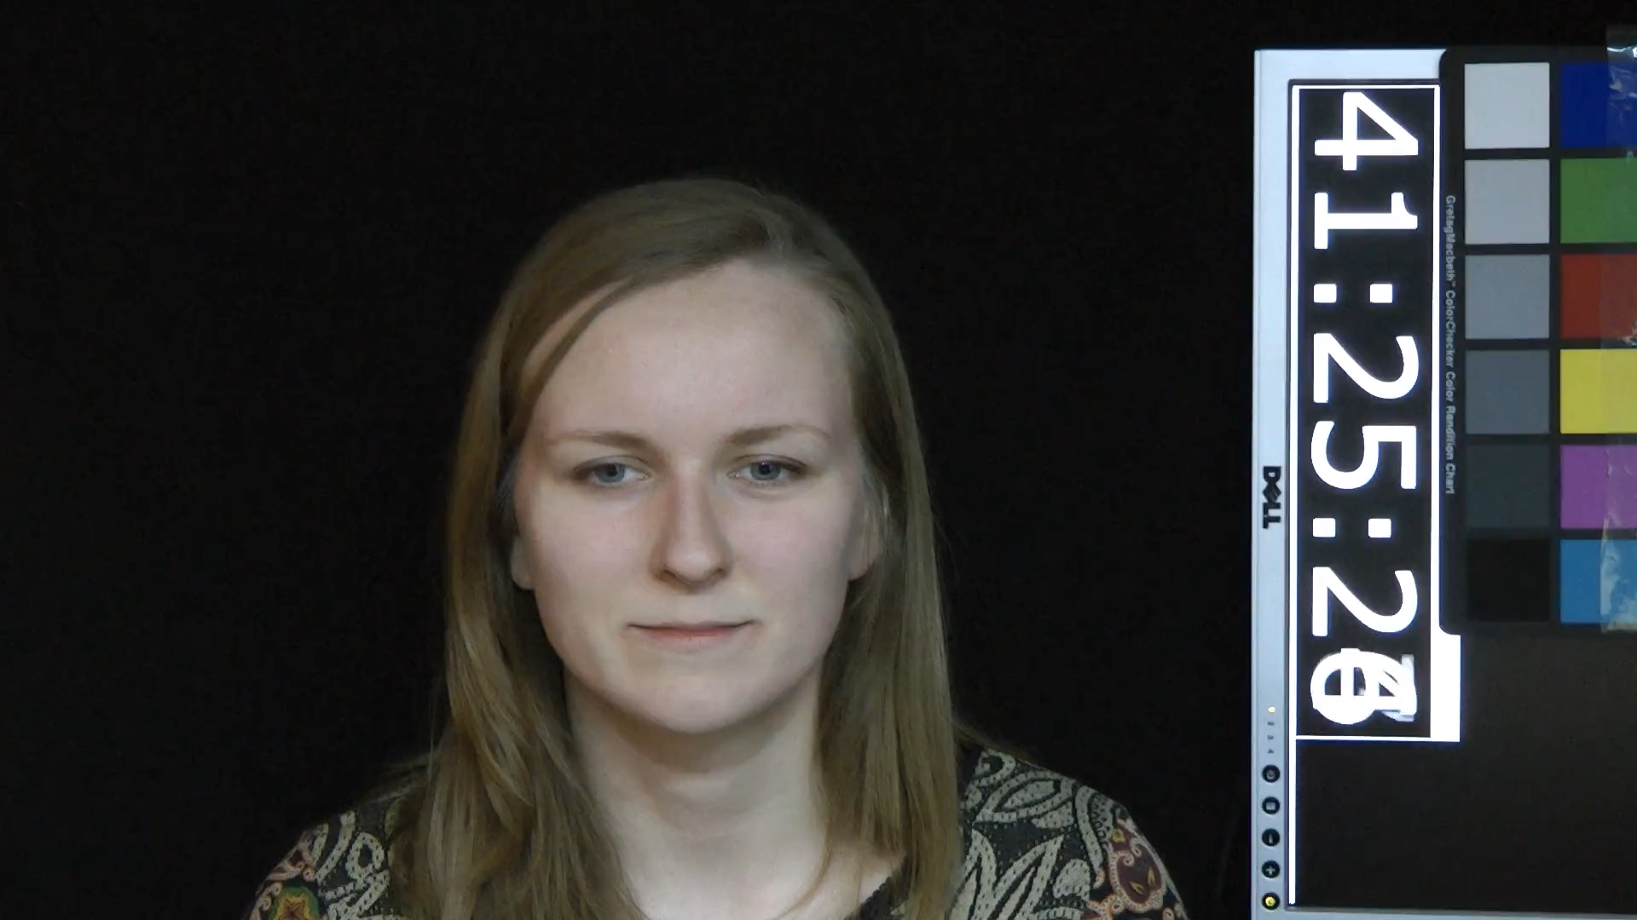
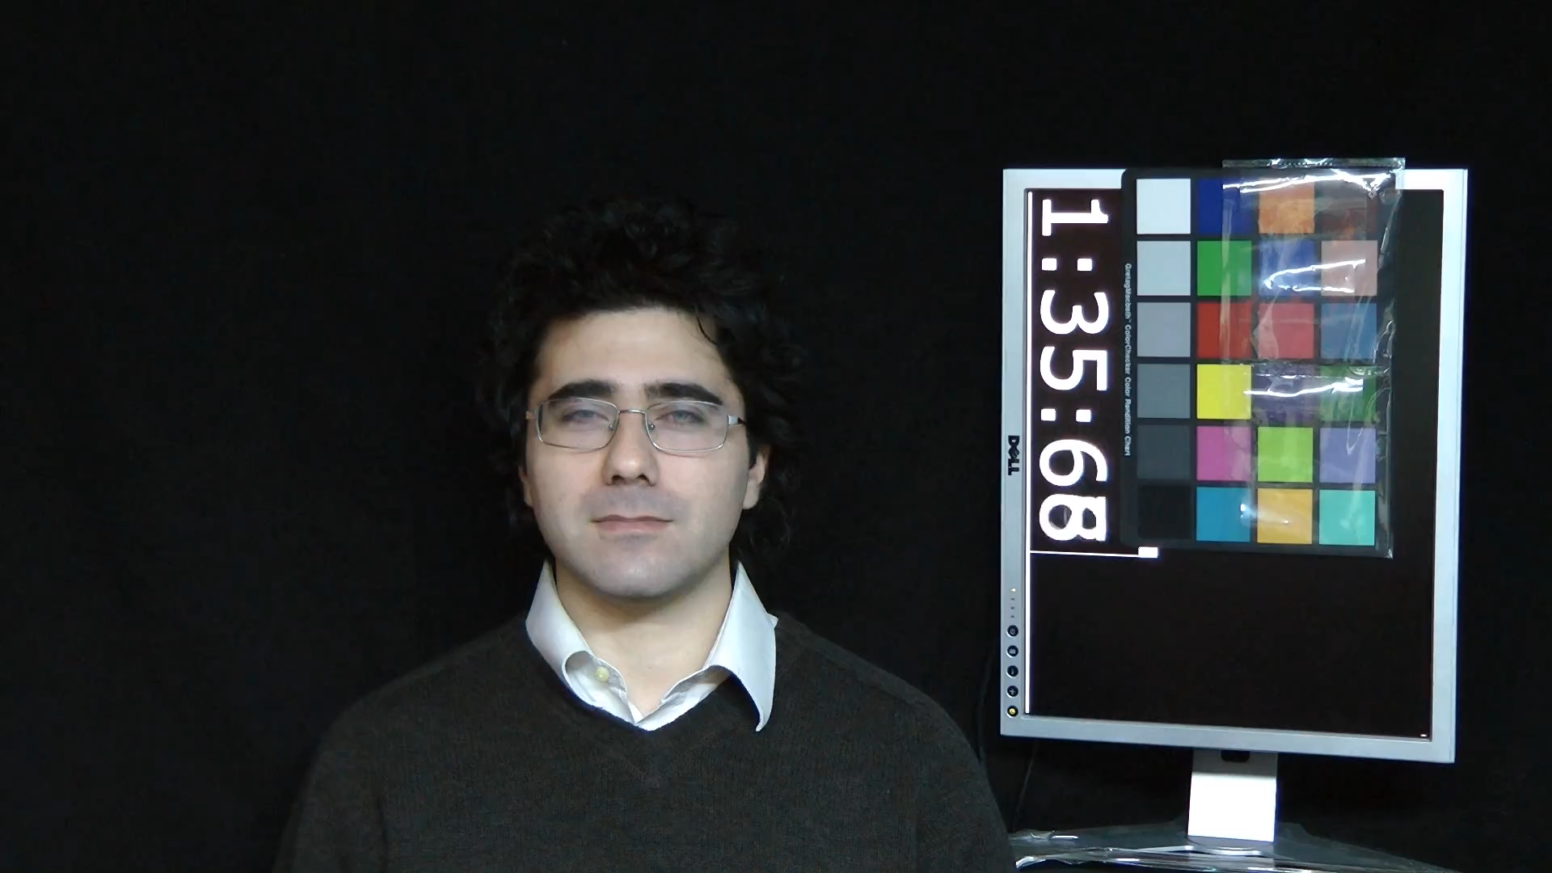
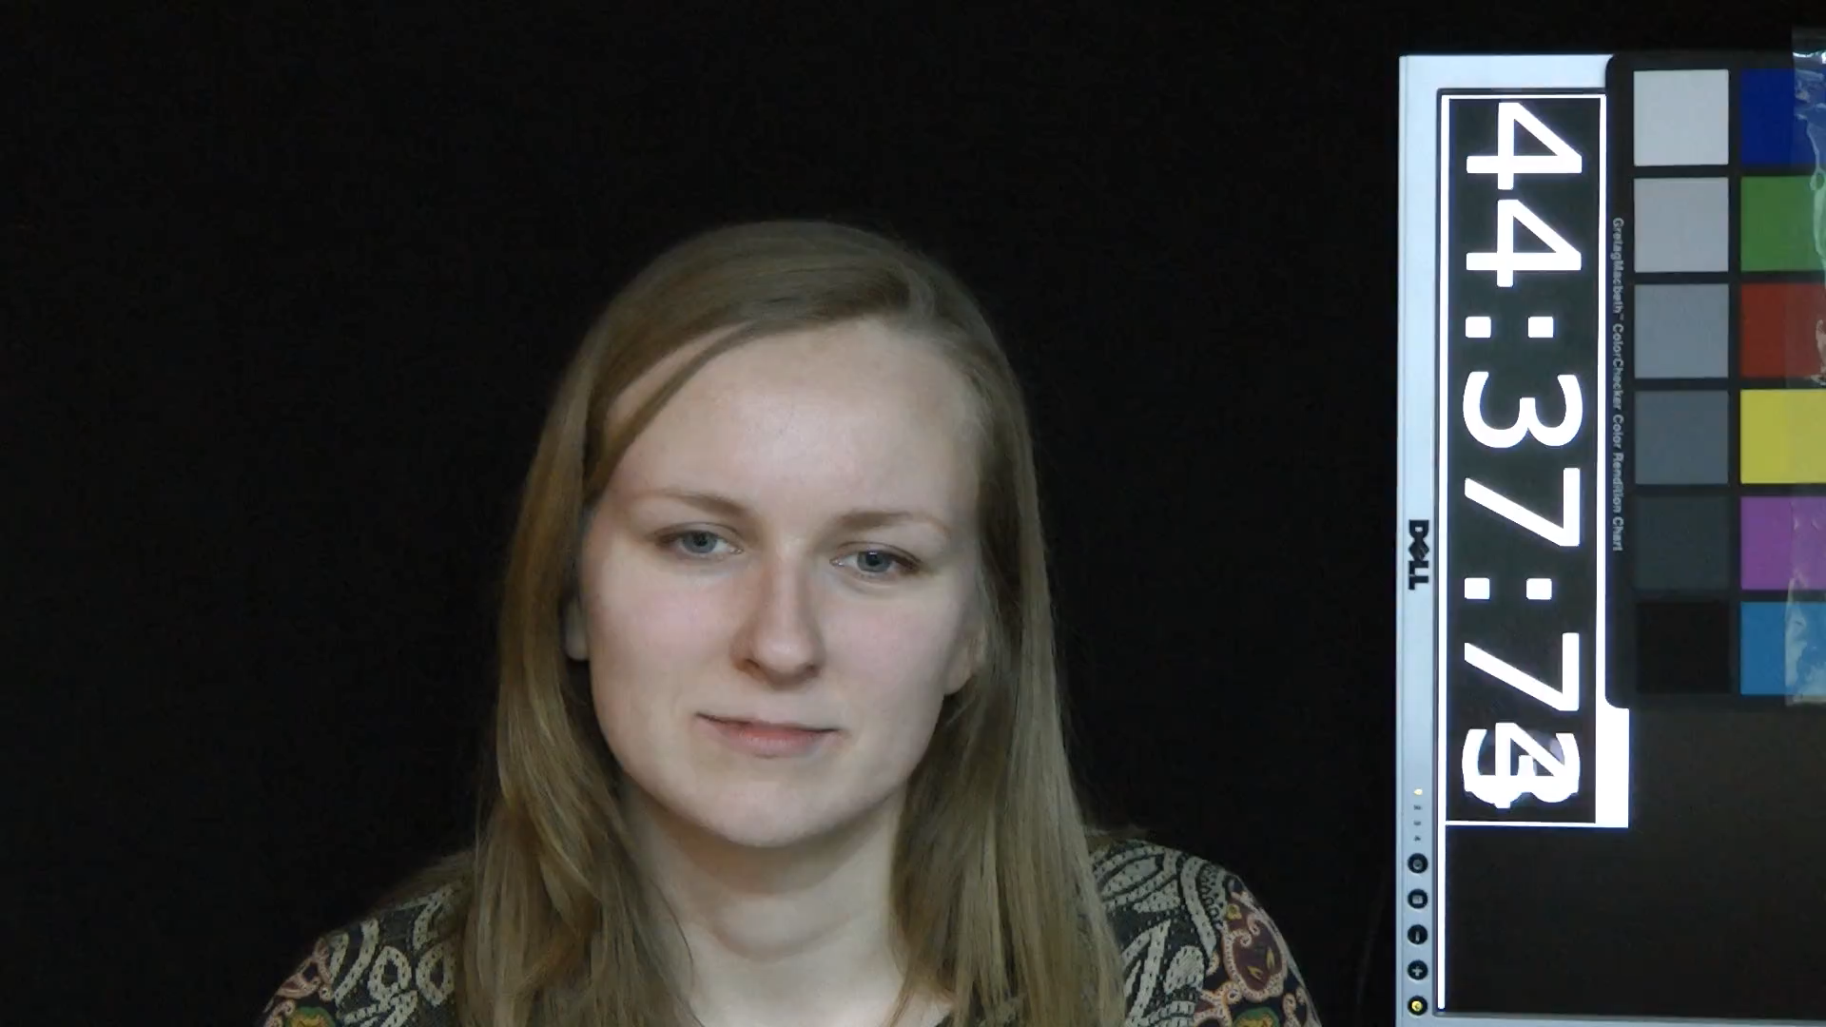
Data Samples
Posed smile:
Spontaneous
smile:

Slide 10
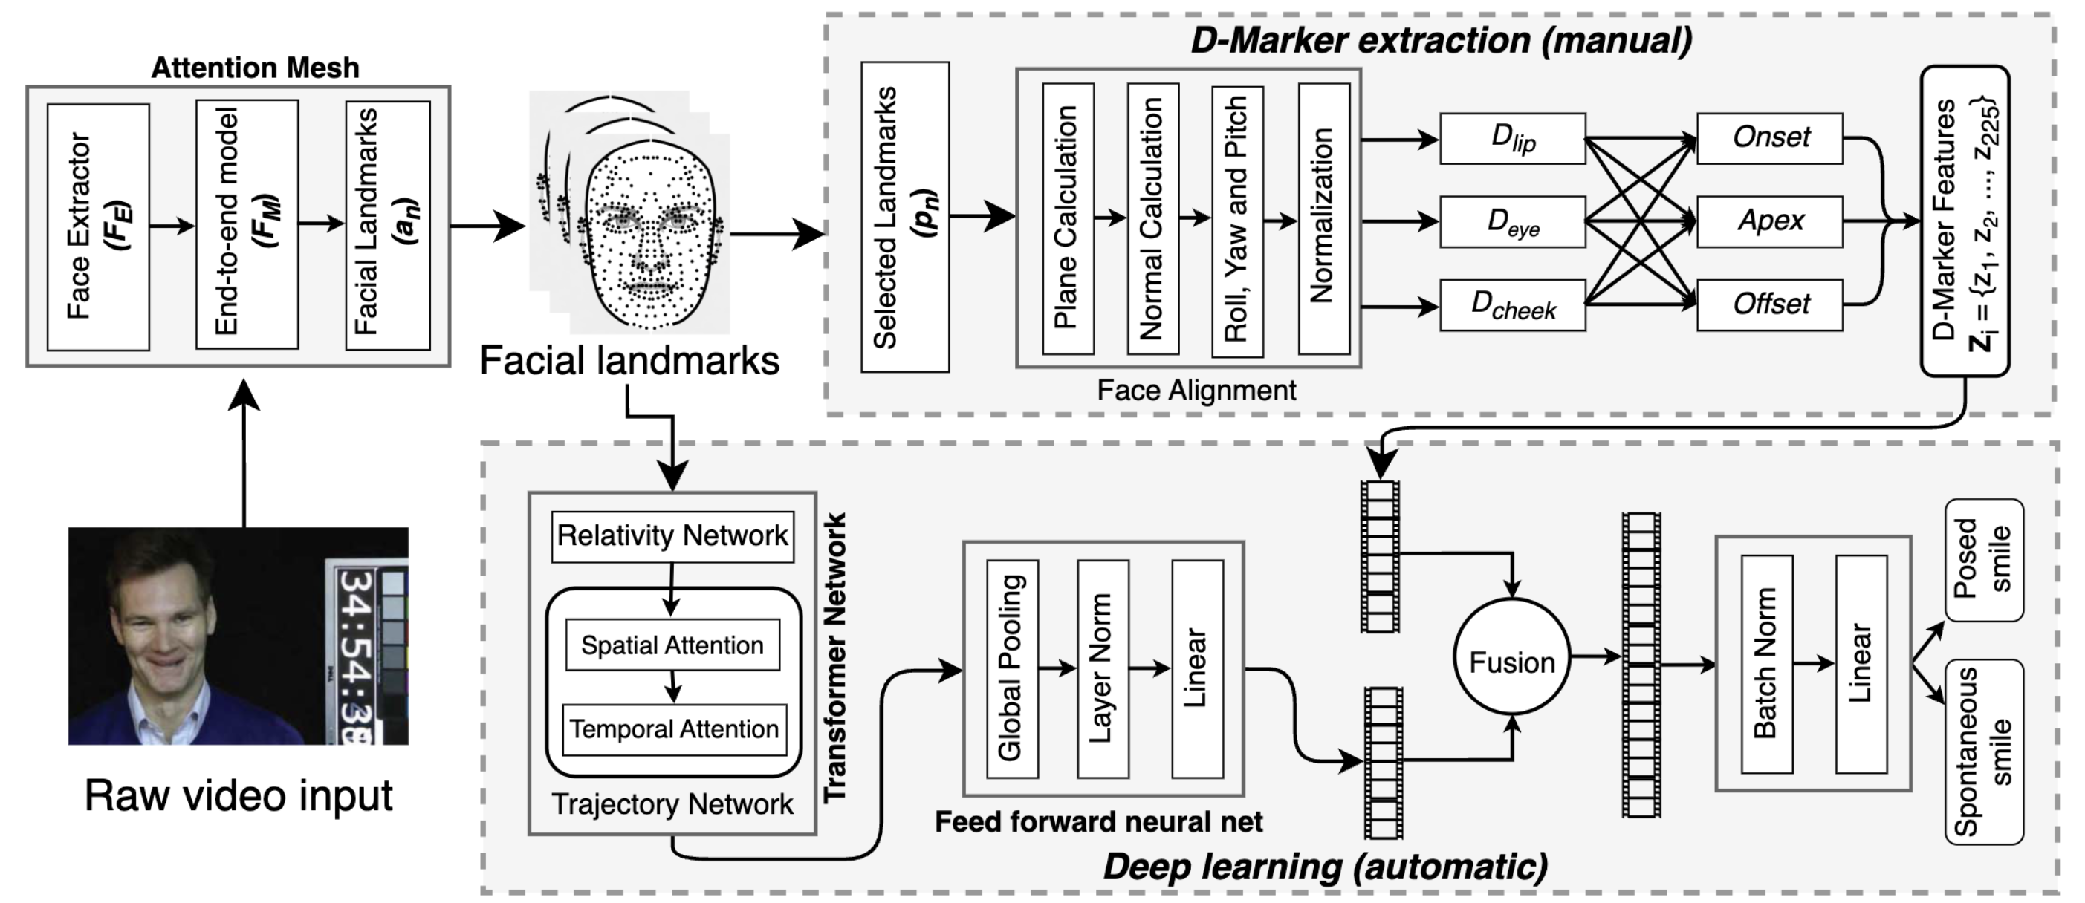
Method

Slide 11
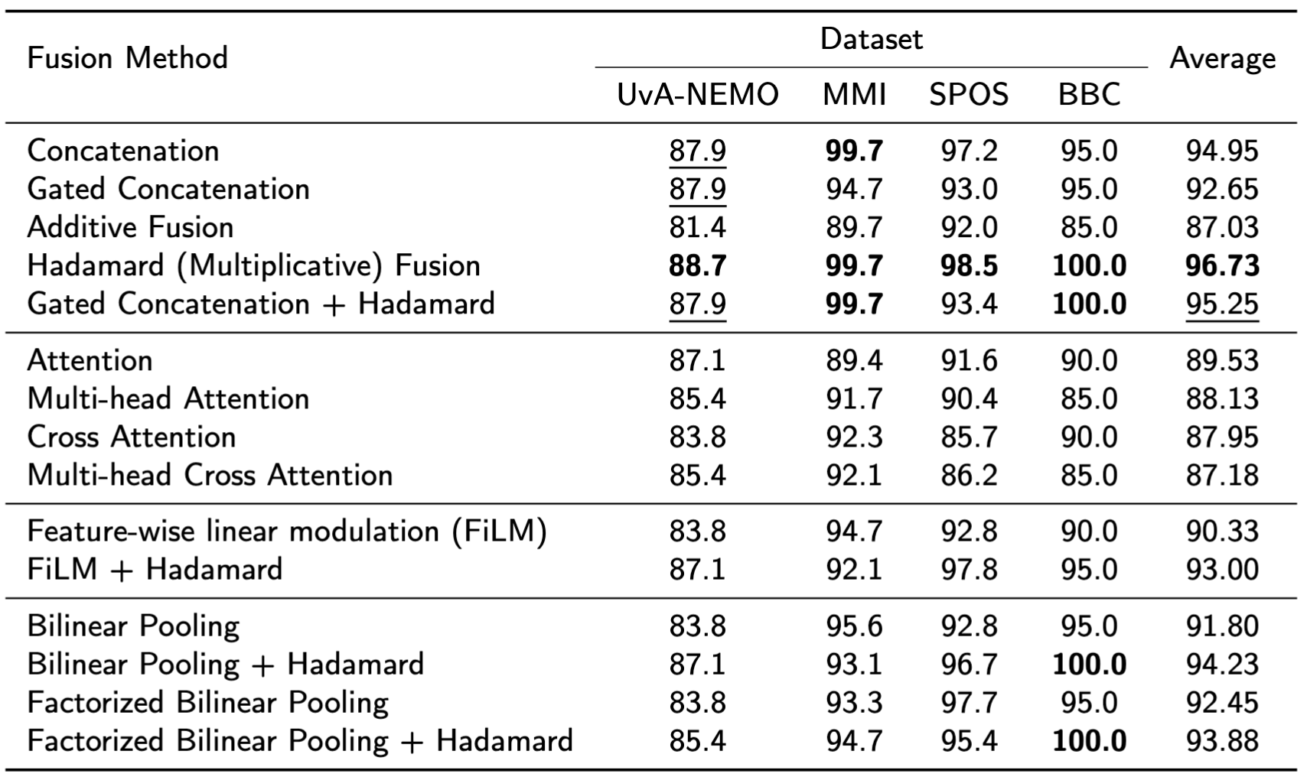
Results with 15 fusion techniques

Slide 12
Comparison with SOTA
Method | UvA-NEMO | MMI | SPOS | BBC
Cohn’04 | 77.3 | 81.0 | 73.0 | 75.0
Dibeklioglu’10 | 71.1 | 74.0 | 68.0 | 85.0
Pfister’11 | 73.1 | 81.0 | 67.5 | 70.0
Wu’14 | 91.4 | 86.1 | 79.5 | 90.0
Dibeklioglu’15 | 89.8 | 88.1 | 77.5 | 90.0
Wu’17 | 93.9 | 92.2 | 81.2 | 90.0
Mandal’17 | 80.4 | - | - | -
Mandal’16 | 78.1 | - | - | -
RealSmileNet’20 | 82.1 | 92.0 | 86.2 | 90.0
PSTNet’22 | 72.9 | 94.3 | 87.1 | 95.0
P4Transformer’21 | 74.9 | 91.3 | 82.9 | 85.0
Vanilla ViT’20 | 78.4 | 99.0 | 93.5 | 95.0
MeshSmileNet’22 | 85.0 | 99.0 | 94.4 | 95.0
DeepMarkerNet’24 | 87.9 | 99.7 | 97.8 | 95.0
Ours (Hadamard Fusion) | 88.7 | 99.7 | 98.5 | 100.0
Performance Gains Across Benchmarks:
• Achieved state-of-the-art performance on 3/4 datasets, with significant improvements on:
• SPOS: 98.5% (+1.3%)
• BBC: 100% (+5.0%)
• UvA-NEMO: 88.7% (trailing Wu et al.’s 93.9%) but fully automatic vs. their manual preprocessing.
• Advances Over DeepMarkerNet:
• Consistent improvements across all datasets:
• UvA-NEMO: +0.8%
• MMI: +0.7%
• SPOS: +1.3%
• BBC: +5.0%
Table 1: Performance comparison with state-of-the-art methods on spontaneous smile recognition. Results reported as classification accuracy (%)

Slide 13
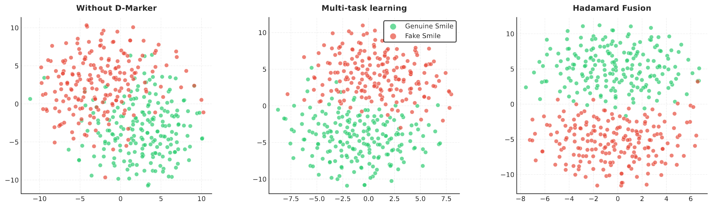
Comparison with SOTA​
Visualization Insights:
• Baseline Model (without D-Markers): Significant overlap between classes, showing poor discriminative power.
• Multi-task Learning: Better class separability but overlapping decision boundaries remain.
• Our Hadamard Fusion Method: Clear class separation with distinct clusters and decision boundaries, showcasing the effectiveness of explicit feature interactions.
Figure: t-SNE visualization of learned feature embeddings from different approaches on the UvA-NEMO dataset. Left: Baseline Middle: DeepMarkerNet’s multi-task learning approach Right: Our Hadamard fusion method

Slide 14
Conclusion and Future Work
Introduced D-FuseSmileNet Framework that Combines transformer-based features with physiologically-grounded D-Markers for effective spontaneous smile recognition.
Eliminated the complexity of hyperparameter tuning required in multi-task learning (e.g., DeepMarkerNet).
Hadamard Fusion boosts learning by directly combining features, enabling complementary and discriminative feature learning.
Future directions can include extending the framework to explore other transformer architectures, incorporating additional modalities like speech and gaze and optimization for real-time applications.
However, our study is limited to within-dataset evaluations, comprehensive cross-dataset evaluations could provide better generalization across different recording conditions and demographics

